Slide 1



Team Falcon
Fine Air

Slide 2



Agenda
Introduction
Idea
Implementation
Features
Vision

Slide 3
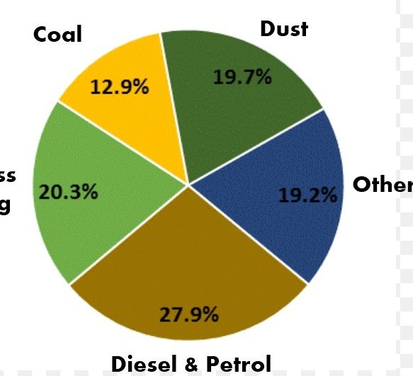
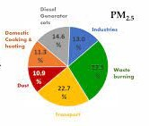
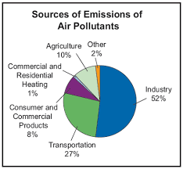
Introduction
Vehicles have a prominent role in our lives. Nearly 27% of the air pollution in India is caused due to vehicles. According to the law, we have a way of monitoring and controlling the pollutants emitted by vehicles, but how efficient it is in controlling vehicle pollution is a different matter. The way to monitor the pollution caused by vehicles is a pollution certificate, which certifies that the vehicle is emitting a certain amount of pollution and if the vehicle emits more than that, they need to get the car serviced. But most vehicles cause more air pollution more than the regulated amount and easily get away with it. So, our pollution monitoring system has a loophole.

Slide 4

Idea
The idea is to fine the citizens who pollute the air more than the permissible limits. We have tried to estimate the true extent of vehicular pollution. In doing so, we will be able to limit the vehicle emissions, completely eradicate the concept of pollution certificates and generate revenue for the government through fines.

Slide 5

Implementation
The idea is implemented by first, monitoring the ppm value of the 3 most harmful gases emitted by the vehicle's exhaust pipe, using an MQ2 gas sensor, six times a day. If the ppm value is more than the appropriate value prescribed by the government, then a challan is generated for that car and the latest ppm values are updated on the real-time database of firebase. The challan generated can be viewed and paid from the user's side, just by logging in with their car number. And the ppm values with the car number and challan status are stored in a real-time database, where every car's information is stored. This database can be used by the government or any other organization to estimate the true total pollution and penalize the 'extra-polluters’.

Slide 6

Features
Our Product is a Unique IOT solution. It does not have any competitors that we know of.
Pollution Check Centers present at petrol pumps are the closest solution offered in the market currently.
Costs around 600Rs to make and is accurate.

Slide 7

Vision
Air pollution is something which has a adverse impact on our environment. We need to take control over it as soon as possible and curbing vehicular emissions play a large role in it. The first step is to truly know the true extent of pollution occurring and then control the excessive amount of pollution. Hence, Team Falcon envisions seeing our product in eachand every vehicle. The goal is to control vehicle pollution as much as possible and eradicate the difference between the pollution projected or estimated and the pollution actually emitted.

Slide 8
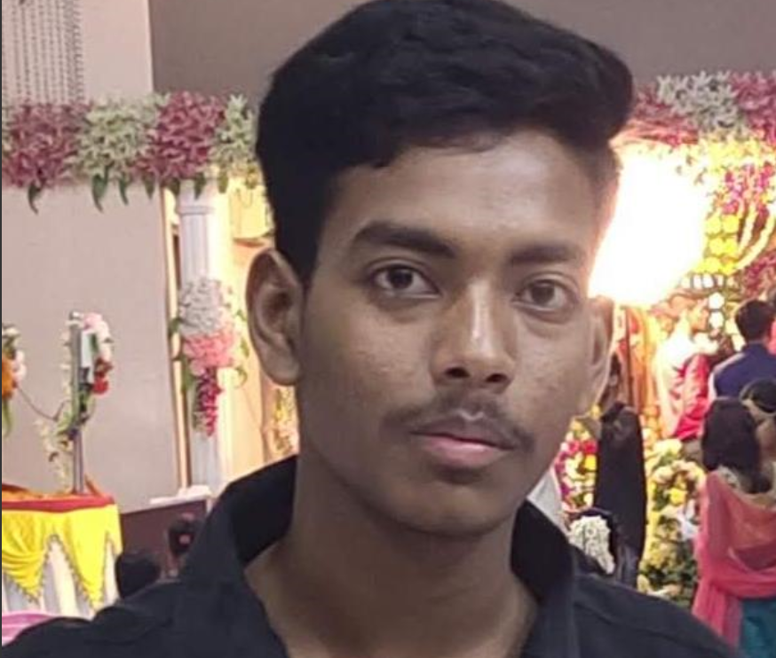

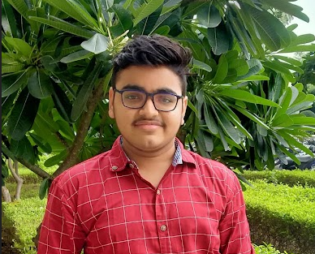

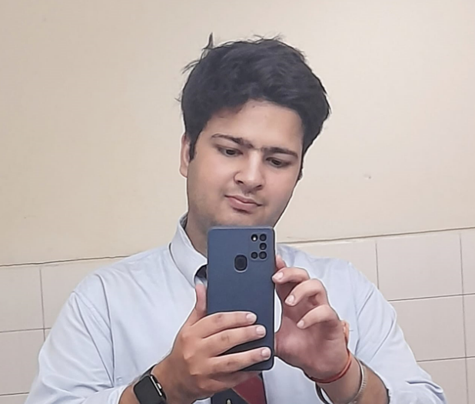
Team
Amritanshu
Aryesh
Devang
(Team Lead)
Shivansh
Tanmay

Slide 9


Thank You
Team Falcon
https://realtimedb2-a99d2.web.app/

